Slide 1

FAKE NEWS LOCATOR
@FakeFinds Amanda Smith Jack Chavez Sanchari Chowdhuri

Slide 2
1.
Our Objective
Where are people talking about fake news on Twitter?

Slide 3
Brainstorming Questions
What data can we get from Twitter?
What counts as ‘fake news’?
Where are people talking about that news?
How can we share that information?
Notes:
Amanda

Slide 4
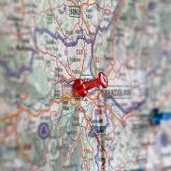
@FakeFinds
Where do we talk about fake news?
What states tweet the most about a specific false story
Alerting local reporters of the trend in their state
Notes:
Amanda

Slide 5
The Process
Data collection
Cleaning & Analysis
Output
Notes:
Amanda

Slide 6
Collection
Notes:
Sanchari

Slide 7
Data and Parameters
Query
Search term containing the keywords of a recent fake news event, i.e. “obama search warrant” or “trey gowdy custody”.
Population
The most recent Census total of population for all 50 states and the District of Columbia.
Location
A user-generated field that determines the location of an account. Responses range from blank to exact street addresses, with non-data spread throughout.
Date
Data will be arranged chronologically in order to create a timeline.
Reporters
A reporter from the largest newspaper in circulation in each state who has previously reported on “fake” news or fact checked, as well as their Twitter handle.
Notes:
Sanchari

Slide 8
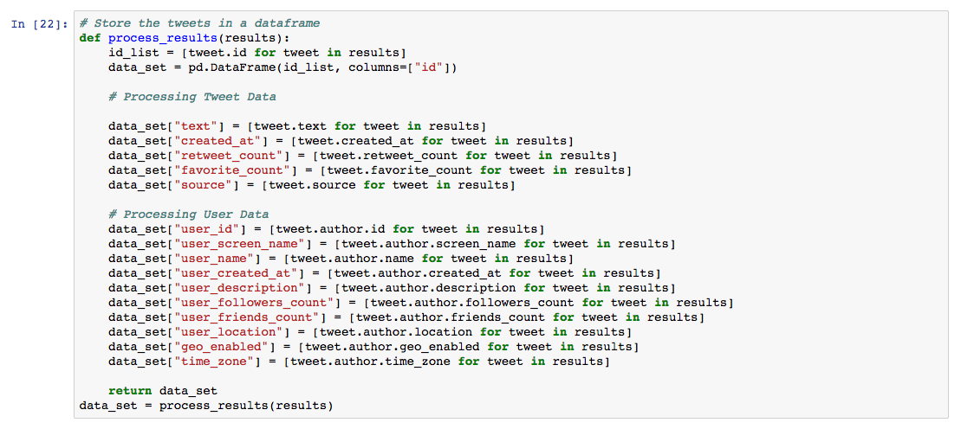
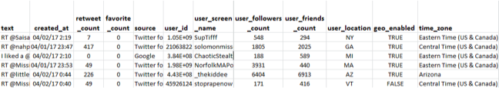
Initial dataset
Notes:
Sanchari

Slide 9
Cleaning & Analysis
Notes:
Sanchari

Slide 10
Basic cleaning
Missing data
Cleaning out data with missing or redundant fields.
Nominatim
Open sourced geocoding that can take vague locations and return specific responses.
Manual check
Sliced locations are still not completely perfect and require a manual check.
Notes:
Sanchari

Slide 11
Normalising the data
Sorting
Aggregate all tweets at a state level, and then chronologically.
Finding the rate
Total number of tweets per state is normalized using the population of each state (rate per thousand).
Notes:
Sanchari

Slide 12

Cleaned dataset

Slide 13
Output
Notes:
Jack

Slide 14
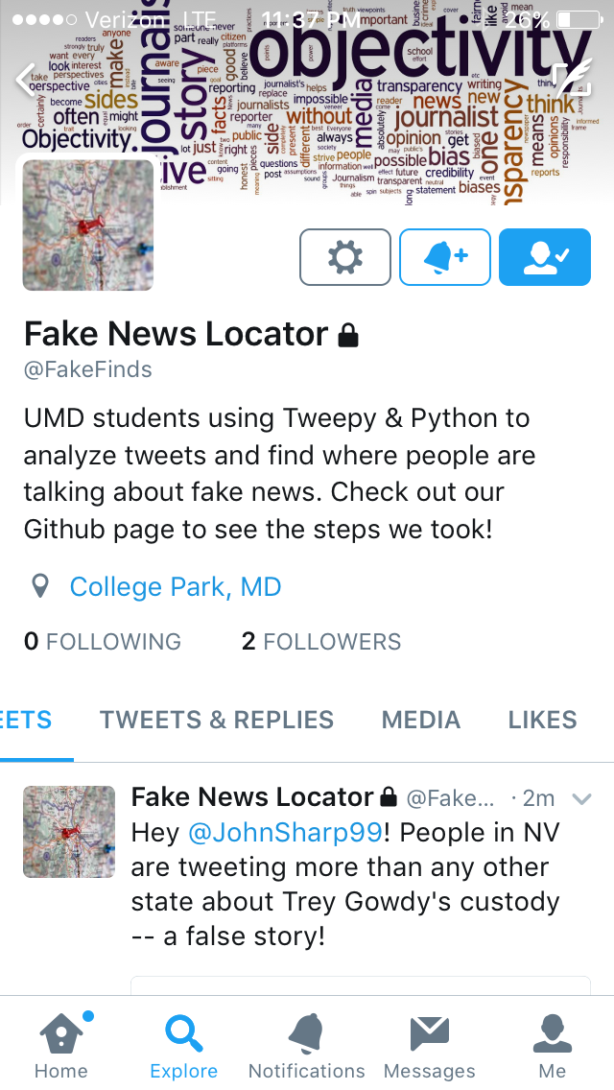
Major components
Bar chart showing which states have the highest rate of tweeting about that false news story
Timeline showing the rate over time
Tweet to a local journalist with this data
Place your screenshot here
Notes:
Jack

Slide 15
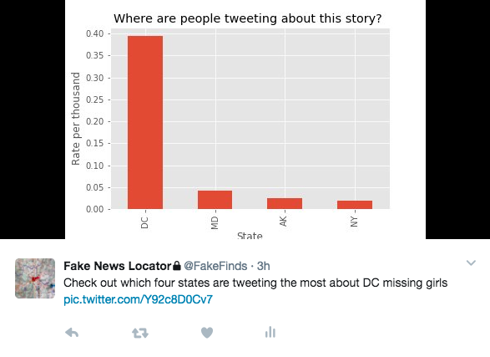
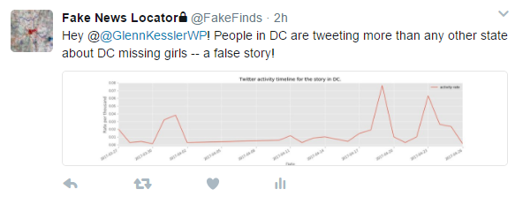
Completed outputs using the ‘DC missing girls’ story

Slide 16
Journalistic Value
Notes:
Jack

Slide 17
Why is this important?
Focus where to fight fake news
Bot aims to fight fake news where it’s being spread
Focusing resources, such as geo-specific Facebook ads, yields a higher chance that those who need to be informed that something is fake will see it
Expand readership of and reinforce trust in your publication
Notes:
Jack

Slide 18
Challenges
Geocoding
No uniform way to find the location -- for free
Requires a manual check
Leads to smaller sample sizes
Alerting the appropriate journalist

Slide 19
Moving forward
Would work best with a paid Twitter API to find more accurate locations
Could include international data then
Run higher quantities of stories to look for trends among states
Larger datasets -- moving beyond fake news

Slide 20
Thank you !

